Slide 1
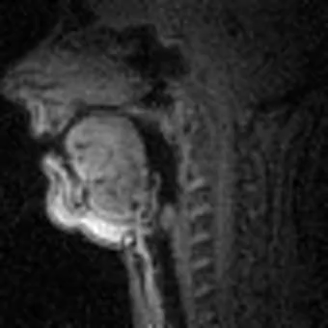

Slide 2
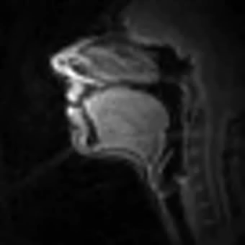
Motor Control
Vocal-Tract Shaping
Intended Utterance
Acoustics
Notes:
We study human speech production, and one of the ways to gain insights into speech production is by trying to simulate the process.
We consider this general pipeline from a textual specification to speech motor control commands to the dynamics of vocal-tract shaping to the resulting acoustic. Our team has been leading the development of real-time MRI of the vocal tract and we want to use these data to inform this simulation.

Slide 3
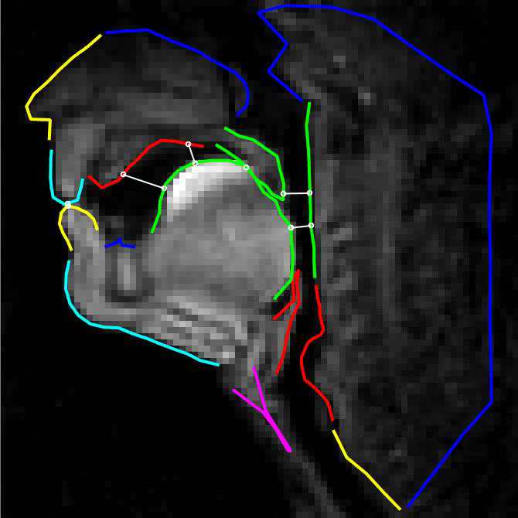

Slide 4
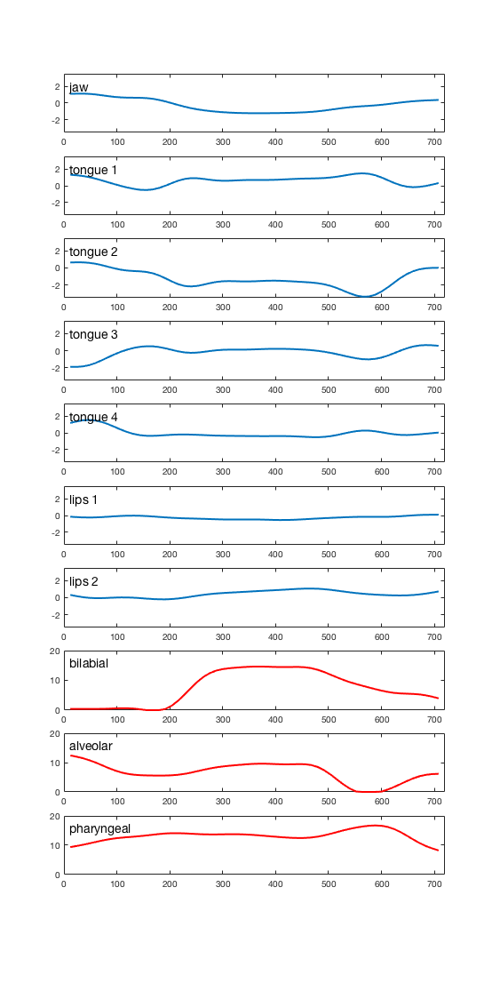
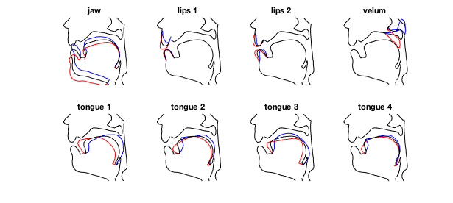
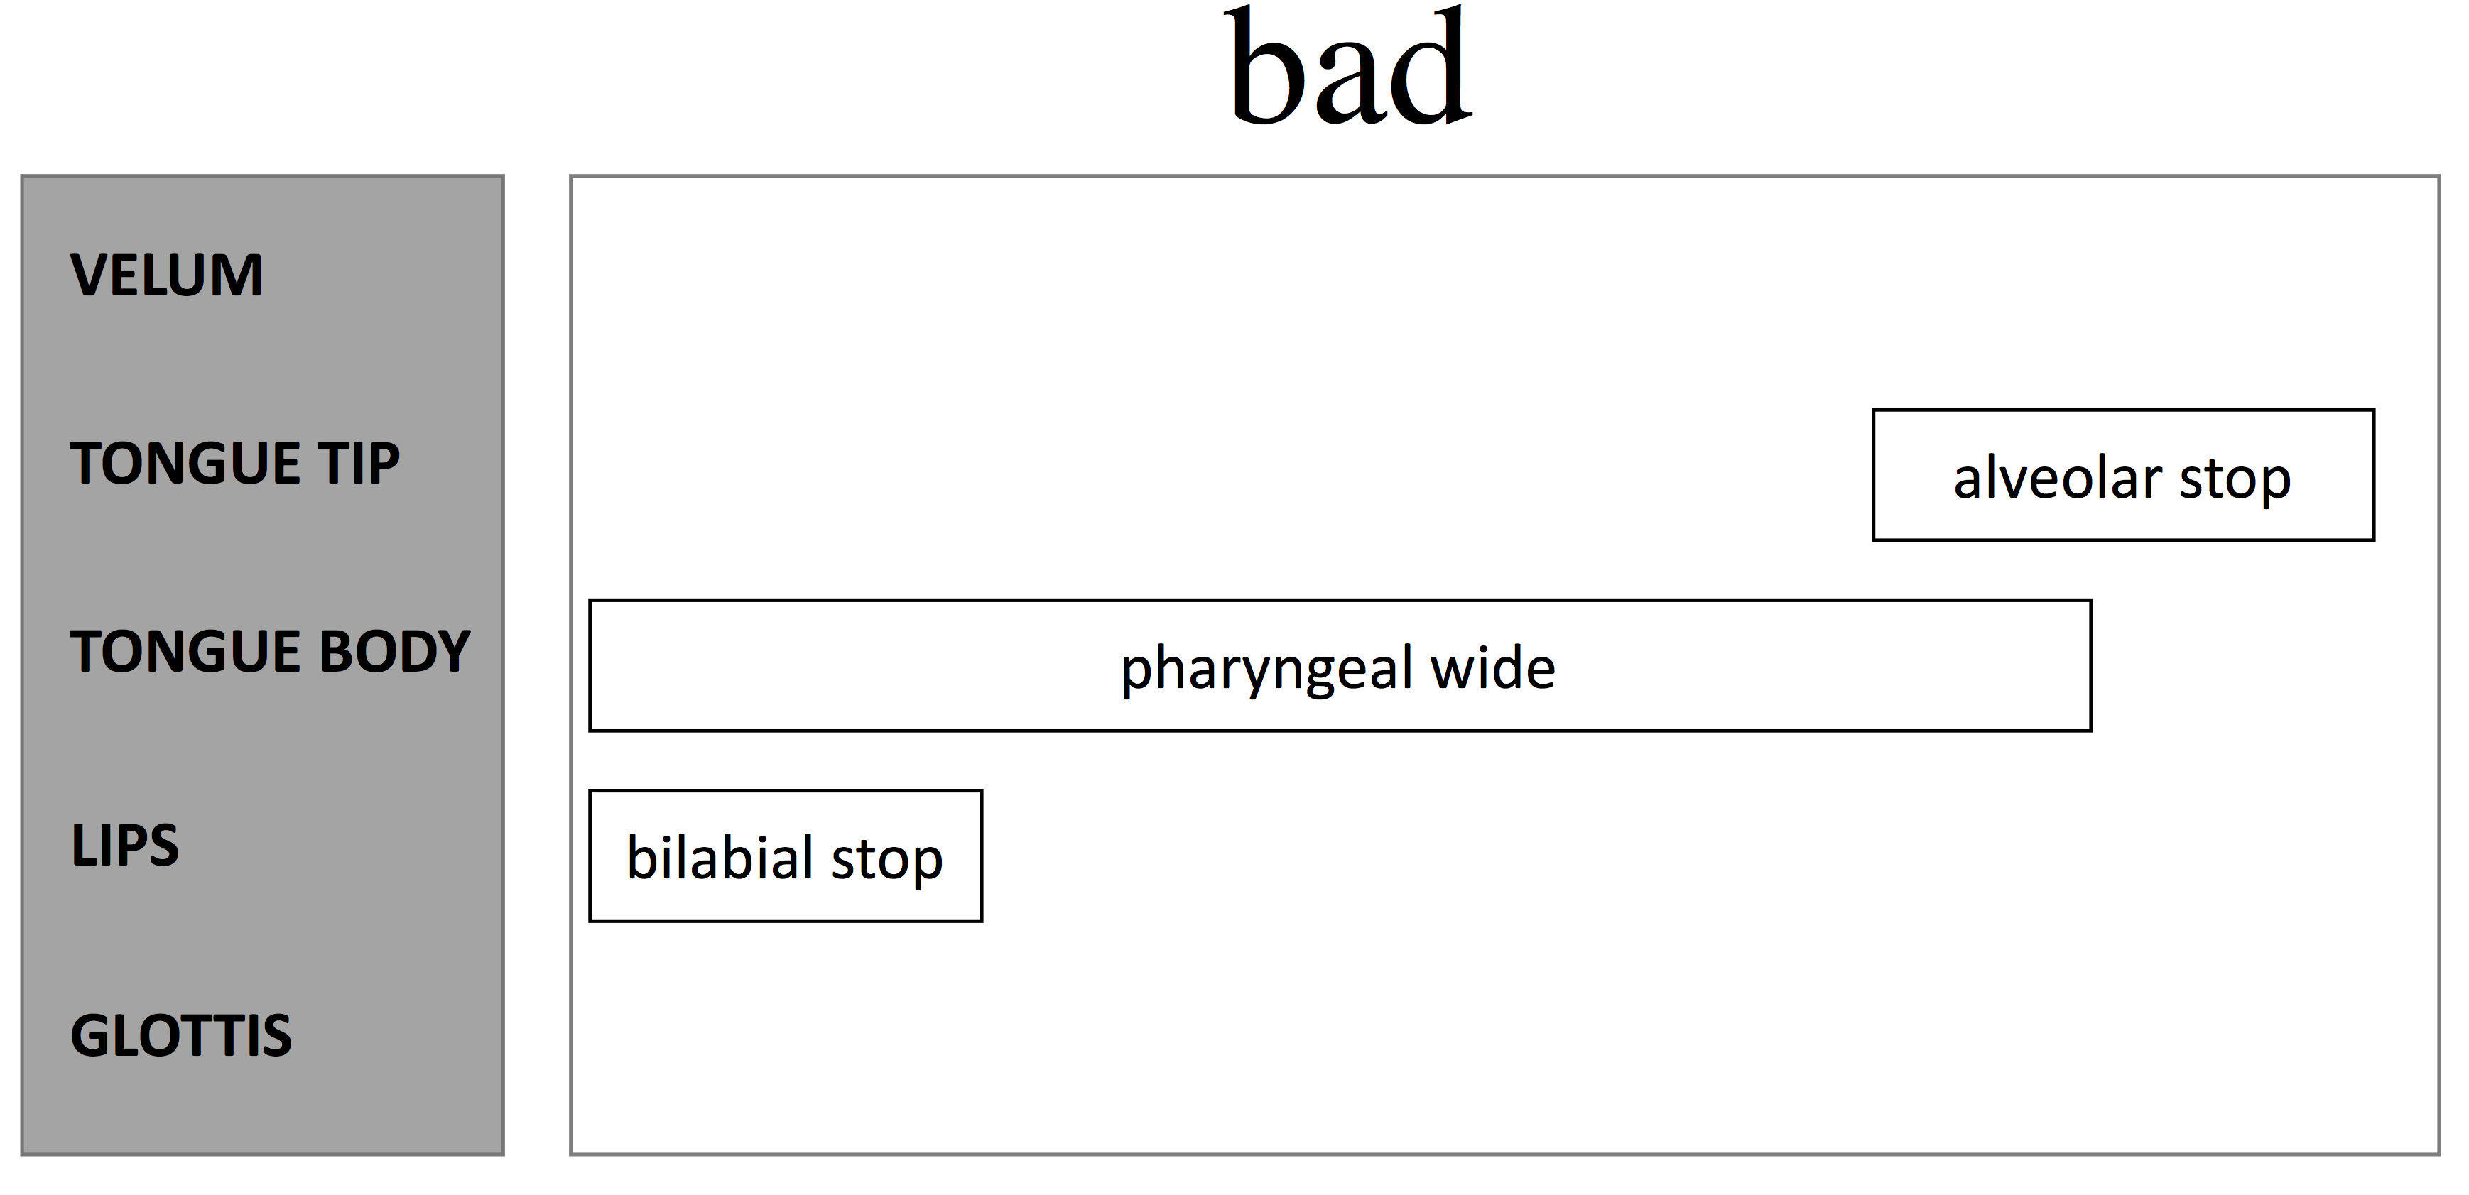
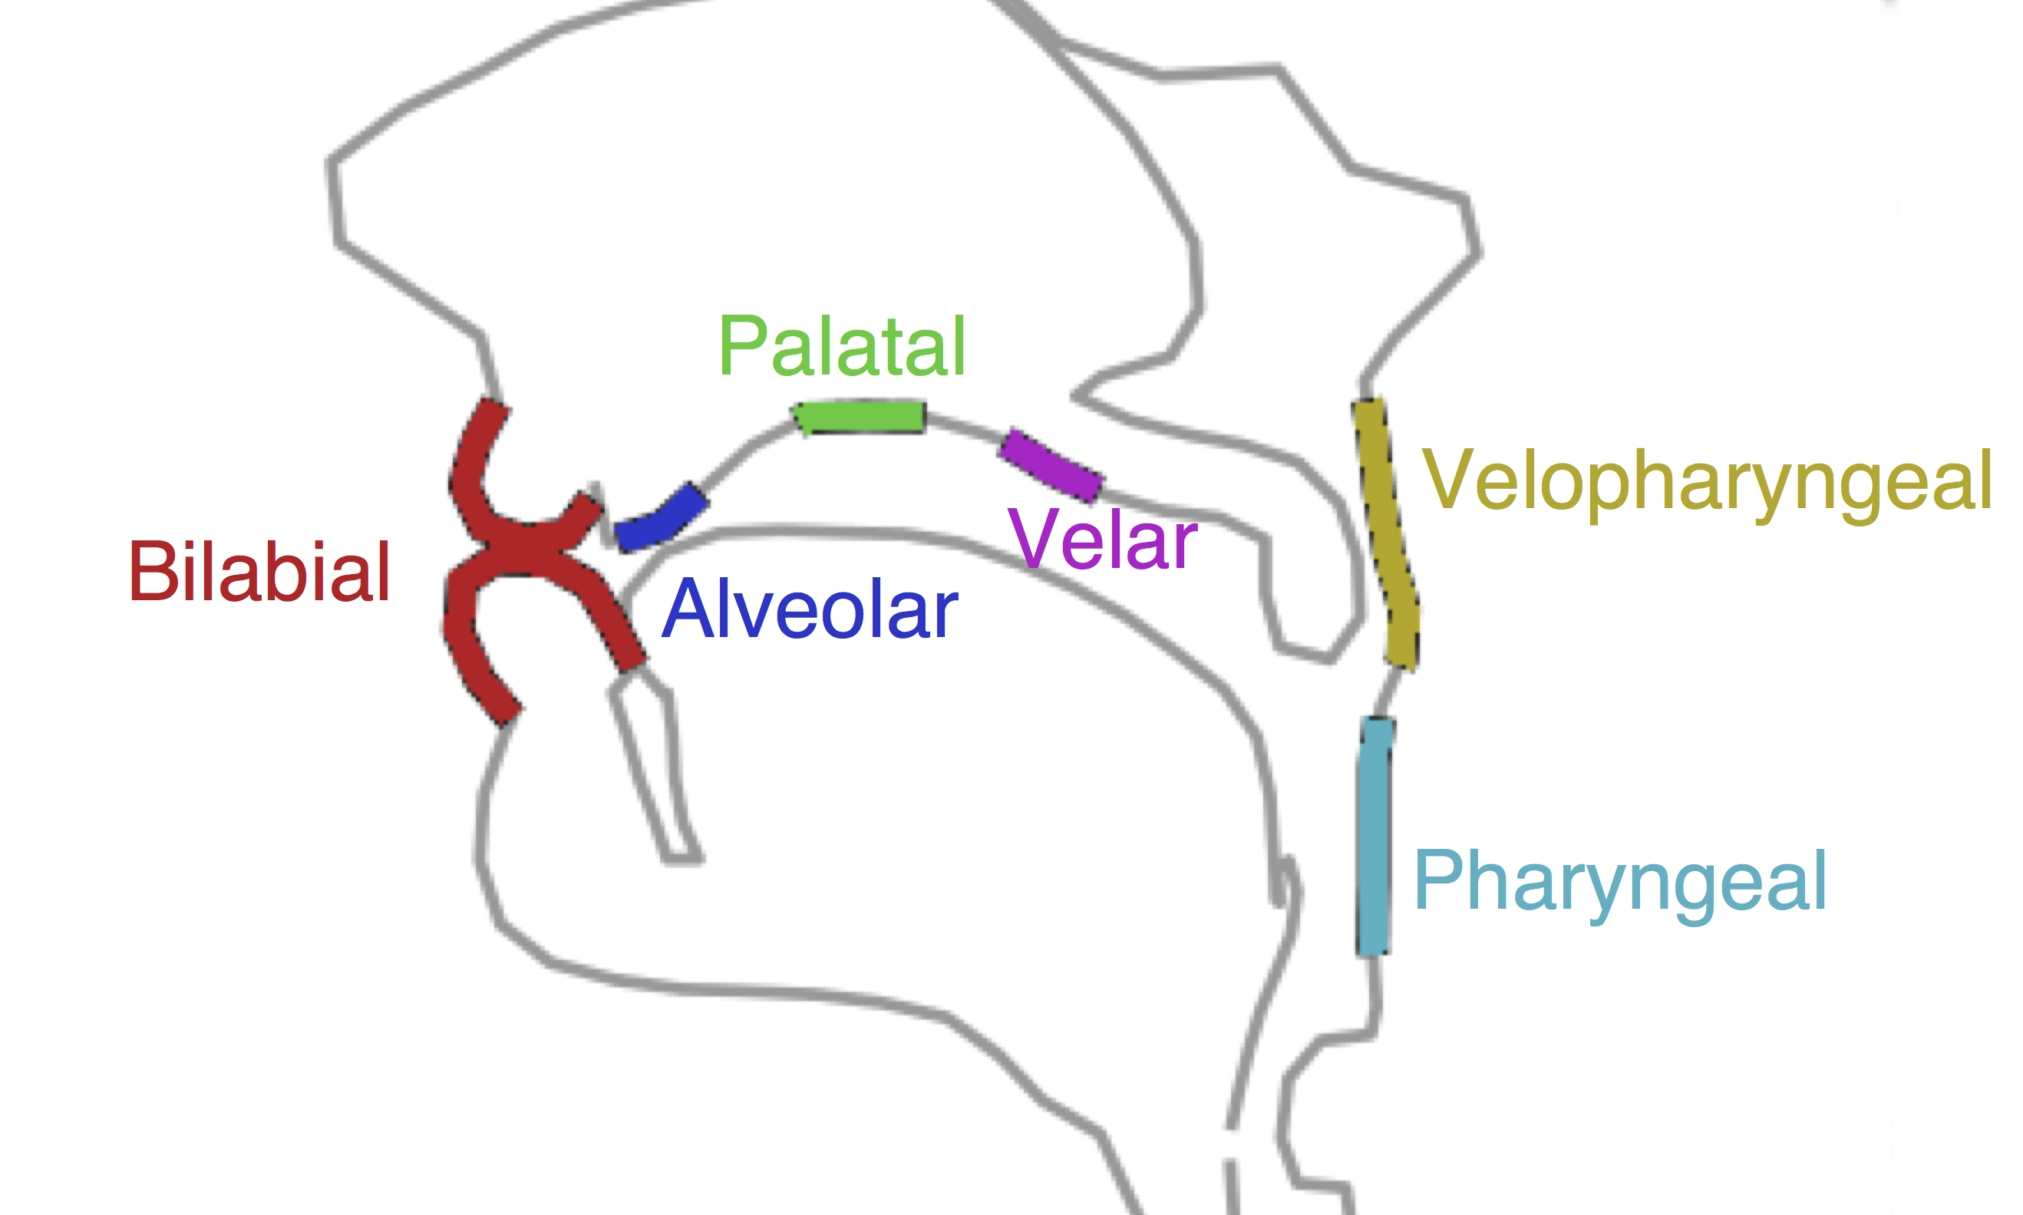
b
a
d
factor-loadings (standard deviations)
constriction degrees (millimeters)
time (milliseconds)

